Slide 1



Automation Platinum Demo
Leveraging ODM decisions in watsonx Orchestrate
Introduction and overview

Slide 2
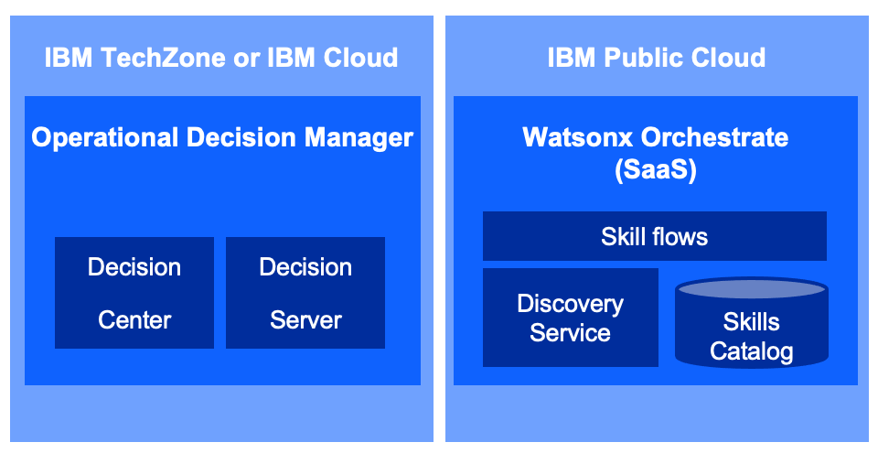
Demo overview
REMOVE THIS SLIDE BEFORE PRESENTING TO CUSTOMERS
Purpose of this deck | This deck is to be shown to customers to introduce and summarize the Leveraging ODM decisions in watsonx Orchestrate Platinum demo.
Scenario overview | The demo uses a customer service example to show how existing ODM decision services can be exposed as watsonx Orchestrate skills.
Product(s) in the demo | Watsonx Orchestrate – IBM Operational Decision Manager
Capabilities to be demonstrated | Watsonx Orchestrate – Discovery Service – Skill flows - Decision Center – Decision Server
Supported product version(s) | Watsonx Orchestrate SaaS – ODM 8.11 ODM 8.12 (On prem or SaaS)
IBM Technology Zone page | https://techzone.ibm.com/collection/leveraging-odm-decisions-in-watsonx-orchestrate
Demo Components

Slide 3
Demo overview
Scenario
Focus Corp wants to improve customer service productivity when dealing with product returns. Agents must currently go through different applications and make manual decisions to process each product return.
Focus Corp wants to reuse the ‘return approval’ decision service they have implemented using ODM and that is currently used in the back office. A decision skill is created using the watsonx Orchestrate discovery service to invoke the existing decision.
To further improve business productivity, a skill flow is created to prevent agents from entering numerous customer and ‘returned items’ fields required to invoke the decision skill. A skill recovering the data from the Focus Corp database is coupled to the new ODM skill.
Each call center agent can now add this new skill in their personal skill set. In just one sentence, or one click, they are able to know in real time, if a purchase can be returned and under which conditions.
IBM Digital Labor Capabilities
watsonx Orchestrate
IBM Operational Decision Manager

Slide 4
Demo flow
Introduction
Show the decision service in ODM
Create a new skill
Focus Corp wants to improve their call center productivity by reusing existing ‘return approval’ decision services
An existing decision service managing ‘approval decision’ is used by the back-office applications
An approval skill able to invoke ODM decisions is created using a discovery service
Publish and use the skill flow
Create a skill flow
Use the skill flow to show how fast an approval is made from a very simple interaction
A skill flow sequencing a database skill and the decision skill is created to reducing manual operations.

Slide 5
Demo components
IBM TechZone or IBM Cloud
IBM Public Cloud
Operational Decision Manager
Watsonx Orchestrate (SaaS)
Skill flows
Decision
Center
Decision
Server
Discovery Service
Skills
Catalog
IBM Public Cloud
IBM TechZone-provided environment or Shared IBM SaaS environments

Slide 6
DEMO
Leveraging ODM decisions in watsonx Orchestrate

Slide 7
Key takeaways
Leveraging ODM decisions in watsonx Orchestrate
Built-in Discovery Service …
Built in wizards to connect to IBM Automation products
Provides connectors to CP4BA on SaaS and CP4BA on premises
Eliminates the complexity to create skills from existing IBM Automation applications
Skill flows bring more value by combining skills in a linear flow to perform more elaborated tasks. Data mapping between 2 consecutive skills is performed automatically based on the output and input data structures.
Rule based automation provides a robust scalable and comprehensive rules management capabilities to author, test deploy, govern and manage complex business policies.
Conversational chat style makes watsonx Orchestrate an assistant you can chat with to perform time consuming tasks for you.
Notes:
auses

Slide 9
Additional learning resources
IBM watsonx Orchestrate
Learn more about the features highlighted in the demonstration:
Connecting to CP4BA - on premises
Combining skills into a skill flow
Enhancing and publishing skills
Working with the Decision Center
Managing rules in the Decision Server

